Slide 1
Basic I/O Interfacing
8255 or 82C55

Slide 2
The programmable peripheral Interface
The 82C55 programmable peripheral interface (PPI) is a very popular low-cost interfacing component that is used found in many applications.
Applications range from 7-segment display, stepper motor connection, counters to key pad management.
This device is still in use today and is used to interface and detect key presses on modern keyboards, parallel printers and other interfacing chipsets.
For those of you who are doing computer interfacing course you will be extensively using this device to interface various devices with the PC.

Slide 3
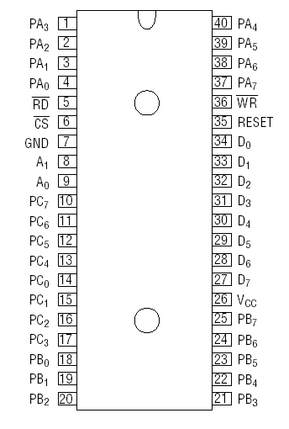
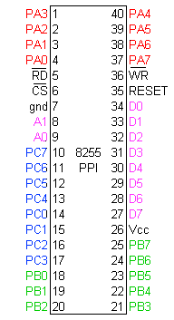
Pin Diagram 8255

Slide 4
Connection Diagram
8 bit
Date and Address Bus
MPU
8255
I/O devices
Control
Register
Port A (8 bit)
Read (Active low)
Port B (8 bit)
Write (Active low)
A0
A1
Port C_{Upper} (4 bit)
Reset (Active high)
Port C_{Lower} (4 bit)
Chip Select (Active low)
A1 | A0 | Function
0 | 0 | Port A
0 | 1 | Port B
1 | 0 | Port C
1 | 1 | Command Registers

Slide 5
Connection Diagram
8 bit
Date and Address Bus
MPU
8255
Port A (8 bit)
Control
Register
Port C_{Upper} (4 bit)
Group A
Read (Active low)
Write (Active low)
A0
Port B (8 bit)
A1
Reset (Active high)
Port C_{Lower} (4 bit)
Group B
Chip Select (Active low)

Slide 6
82C55
This devices has 24 pins for I/O.
The I/O pins can be programmed in groups of 12 pins.
There are three distinct modes of operation Mode 0, Mode 1 and Mode 2.
Group A connections consists of Port A(PA0-PA7) and the upper half of port C (PC4-PC7)
Group B connections consists of Port B (PB0-PB7) and the lower half of port C (PC0-PC3)

Slide 7
Function of pins:
Data bus(D₀-D₇):These are 8-bit bi-directional buses, connected to 8085 data bus for transferring data.
CS: This is Active Low signal. When it is low, then data is transfer from 8085.
Read: This is Active Low signal, when it is Low read operation will start.
Write: This is Active Low signal, when it is Low Write operation will start.

Slide 8
82C55
CS pin is used to select the device for reading or writing.
Control lines A0 and A1 are used to select the Port that requires interaction.
A1 | A0 | Function
0 | 0 | Port A
0 | 1 | Port B
1 | 0 | Port C
1 | 1 | Command Registers

Slide 9
RESET: This is used to reset the device. That means clear control registers.
PA₀-PA₇:It is the 8-bit bi-directional I/O
pins used to send the data to peripheral
or to receive the data from peripheral.
PB₀-PB₇:Similar to PA
PC₀-PC₇:This is also 8-bit bidirectional I/O pins. These lines are divided into two groups.
PC₀ to PC₃(Lower Groups)
PC₄ to PC₇ (Higher groups)
These two groups working in separately using 4 data’s.

Slide 10
Connection Diagram
8 bit
Date and Address Bus
MPU
8255
I/O devices
Control
Register
Port A (8 bit)
Read (Active low)
Port B (8 bit)
Write (Active low)
A0
A1
Port C_{Upper} (4 bit)
Reset (Active high)
Port C_{Lower} (4 bit)
Chip Select (Active low)
A1 | A0 | Function
0 | 0 | Port A
0 | 1 | Port B
1 | 0 | Port C
1 | 1 | Command Registers

Slide 11
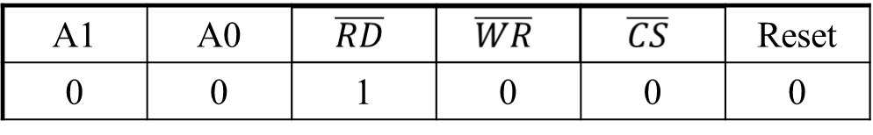
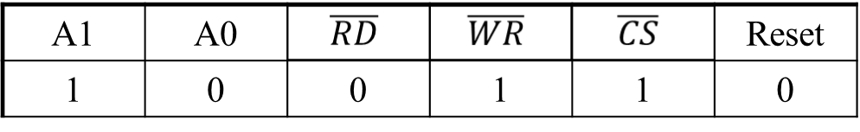
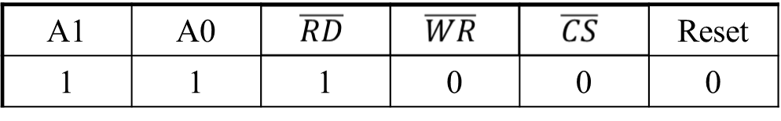
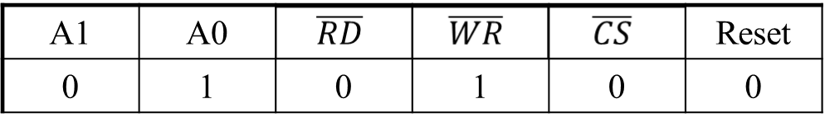
Click on Correct Answer
Data Bus → Port A
Data Bus → Port C
Data Bus → Control
Data Bus → Port C
Data Bus ← Port C
Nothing Happen
Data Bus ← Port A
Data Bus → Port C
Data Bus → Control
Date Bus ← Port B
Date Bus → Port B
Date Bus → Control

Slide 12
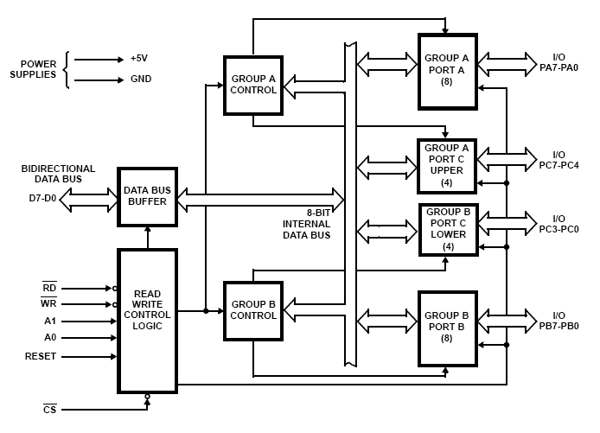
Block Diagram

Slide 13
Data Bus buffer:
It is a 8-bit bidirectional Data bus.
Used to interface between 8255 data bus with system bus.
The internal data bus and Outer pins D₀-D₇ pins are connected in internally.
The direction of data buffer is decided by Read/Control Logic.

Slide 14
Group A and Group B control:
Group A and B get the Control
Signal from CPU and send the command to the individual control blocks.
Group A send the control signal to port A and Port C (Upper) PC7-PC4.
Group B send the control signal to port B and Port C (Lower) PC3-PC0.
PORT A:
This is a 8-bit buffered I/O latch.
It can be programmed by mode 0 , mode 1, mode 2 .
Notes:
Buffered I/O latch: Means buffered to keep power level and latched means will not changed until IO operation completed

Slide 15
PORT B:
This is a 8-bit buffer I/O latch.
It can be programmed by mode 0 and mode 1.
PORT C:
This is a 8-bit Unlatched buffer Input and an Output latch.
It is splitted into two parts.
Support only mode 0
It can be programmed by bit set/reset operation.
Notes:
Output are latched: Will be giving same output until we change it like a memory.
Inputs are buffered: Just keep the power level of input but will not store like latch.

Slide 16
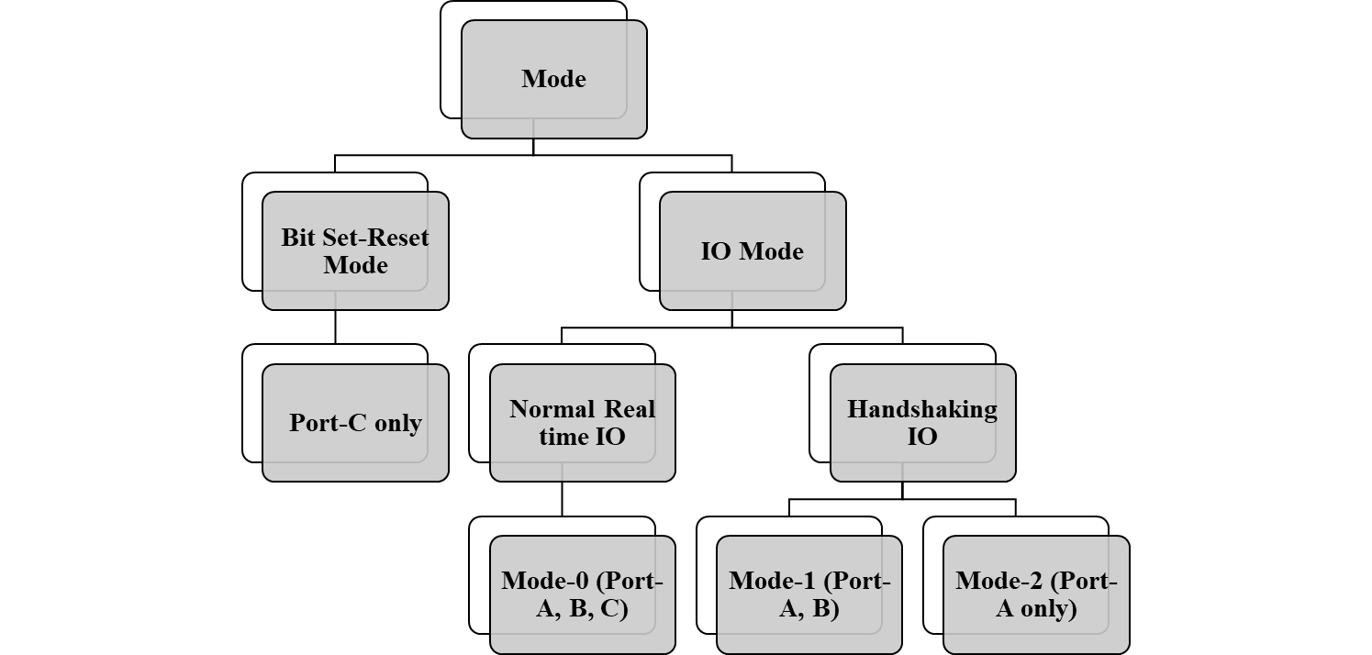
Mode

Slide 17
FOR BIT SET/RESET MODE:
This is bit set/reset control word format.
X X X
Don’t care
Bit select
B0
B1
B2
D7 | D6 | D5 | D4 | D3 | D2 | D1 | D0
BIT SET/RESET
1=SET
0=RESET
0 | 1 | 2 | 3 | 4 | 5 | 6 | 7
0 | 1 | 0 | 1 | 0 | 1 | 0 | 1
0 | 0 | 1 | 1 | 0 | 0 | 1 | 1
0 | 0 | 0 | 0 | 1 | 1 | 1 | 1
BIT SET/RESET FLAG
=0 Active

Slide 18
Operation modes:
BIT SET/RESET MODE:
A pin of PORT C (PC0-PC7)can be Set or Reset by sending OUT instruction to the CONTROL registers.
Example:
PC3 is Set then control register will be 0XXX0111.
PC4 is Reset then control register will be 0XXX1000.
X is a don’t care.
Notes:
Output are latched: Will be giving same output until we change it like a memory.
Inputs are buffered: Just keep the power level of input but will not store like latch.

Slide 19
Bit Set-Reset Mode
MPU
8255
Port A (8 bit)
0XXX0110
Control
Register
Read → 1
Port B (8 bit)
Write → 0
A0 → 0
PC₇
A1 → 1
0
Port C
Reset → 0
Chip Select → 0
PC₀
000→0
001→1
010→2
011→3
100→4
101→5
110→6
111→7
PC₅=101
0 | X | X | X | 1 | 0 | 1 | 0
Control Register

Slide 20
Bit Set-Reset Mode
MPU
8255
Port A (8 bit)
0XXX0110
Control
Register
Read → 1
Port B (8 bit)
Write → 0
A0 → 0
PC₇
0
A1 → 1
Port C
Reset → 0
Chip Select → 0
PC₀
PC₇=111
0 | X | X | X | 1 | 1 | 1 | 0
Control Register

Slide 21
Bit Set-Reset Mode
8255
Port A (8 bit)
Control
Register
Port B (8 bit)
PC₇
0
Port C
PC₀

Slide 22
Click on Correct Answer
PC7 Set
PC2 Reset
Both are wrong answer
01110100→
01010XXX
0XXX1010
0XXX1011
We want to PC5 set→
PC0 Set
PC7 Reset
Both are wrong answer
00000000→
PC2 Set
PC2 Reset
In I/O Mode
01010101→

Slide 23
I/O MODES
MODE 0(Simple input / Output):
In this mode , port A, port B and port C is used as individually (Simply).
Features:
Outputs are latched, Inputs are buffered not latched.
Ports do not have Handshake or interrupt capability.
Notes:
Output are latched: Will be giving same output until we change it like a memory.
Inputs are buffered: Just keep the power level of input but will not store like latch.

Slide 24
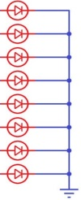
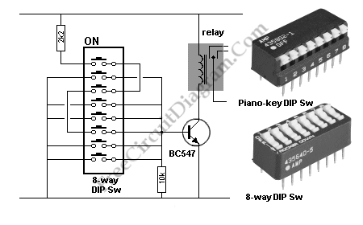
Mode-0
Port A (8 bit)
8 LED
00001111
8255
Control
Register
Port B (8 bit)
8 LED
Port C_{Upper} (4 bit)
Port C_{Lower} (4 bit)
Switches

Slide 25
MODE 1 :(Input/output with Hand shake)
In this mode, input or output is transferred by hand shaking Signals.
Handshaking signals is used to transfer data between whose data transfer rate is not same.
11011011
5-Data will transfer
Keyboard
DATA BUS
STB
ACK
Busy
Processor
1-0,3-1
2-0, 6-1
2-1…4-0

Slide 26
Example:
The computer send the data to the printer large speed compared to the printer.
When computer send the data according to the printer speed at the time only, printer can accept.
If printer is not ready to accept the data then after sending the data bus , computer uses another handshaking signal to tell printer that valid data is available on the data bus.
Each port uses three lines from port C as handshake signals

Slide 27

Mode-1
8255
Port A (8 bit)
Control
Register
Printer
Port C_{Upper} (Pin 3, 6, 7)

Slide 28
MODE 2:bi-directional I/O data transfer:
This mode allows bidirectional data transfer over a single 8-bit data bus using handshake signals.
This feature is possible only Group A
Port A is working as 8-biy bidirectional IO.
PC3-PC7 is used for handshaking purpose.
The data is sent by CPU through this port, when it is required.

Slide 29

Mode-2
1 | 1 | X | X | X | 0 | 0 | 1
8255
Port A (8 bit)
Control
Register
Touch
Screen
Port C_{Upper} (Pin 3, 4, 5, 6, 7)

Slide 30
FOR I/O MODE:
The format of control word
D7 | D6 | D5 | D4 | D3 | D2 | D1 | D0
Group A
Port C Upper 1=Input 0=Output
Port A 1=Input 0=Output
Mode selection 00=mode 0 01=mode 1 1x=mode 2
Group B
Port C Lower 1=Input 0=Output
Port B 1=Input 0=Output
Mode selection 0=mode 0 1=mode 1
Mode set flag=1=Active

Slide 31
Control word format
Group-A
Group-B
Bit Set-reset/
IO Operation
1
Port-C_{upper}
Port-C_{lower}
Mode-1
Port-A
Port-B
Mode

Slide 32
Details connections of 82C55
8-bit data bus buffer
8-bit buffered I/O latch
MPU
8255
Port A (8 bit)
Read
Port B (8 bit)
Write
A0
A1
Port C_{Upper} (4 bit)
Reset
Control
Register
Port C_{Lower} (4 bit)
Chip Select
8-bit Unlatched buffer Input and an Output latch

Slide 33
Writing to Control word for Mode-0
Port A (8 bit)
8 LED
MPU
10001001
8255
Control
Register
Read → 1
Port B (8 bit)
Write → 0
8 LED
A0 → 1
A1 → 1
Port C_{Upper} (4 bit)
Reset → 0
Port C_{Lower} (4 bit)
Switches
Chip Select → 0
1 | 0 | 0 | 0 | 1 | 0 | 0 | 1
Control Register

Slide 34

Writing to Control word for Mode-1
MPU
8255
Port A (8 bit)
1010X11X
Control
Register
Printer
Read → 1
Write → 0
Port C_{Upper} (Pin 3, 6, 7)
A0 → 1
Port B (8 bit)
A1 → 1
Reset → 0
Keyboard
Chip Select → 0
Port C_{Lower} (Pin 0, 1, 2)
1 | 0 | 1 | 0 | X | 1 | 1 | X
Control Register

Slide 35
Writing to Control word for Mode-2
Control Register configure
Input from Keyboard
Print that to touch screen
Also read from touch screen
MPU
8255
Port A (8 bit)
Control
Register
Touch
Screen
Read → 0
Write → 1
Port C_{Upper} (Pin 3, 4, 5, 6, 7)
A0 → 0
Port B (8 bit)
A1 → 0
Reset → 0
Keyboard
Chip Select → 0
Port C_{Lower} (Pin 0, 1, 2)
A1 | A0 | Function
0 | 0 | Port A
0 | 1 | Port B
1 | 0 | Port C
1 | 1 | Command Registers
1 | 1 | X | X | X | 1 | 1 | X
Control Register

Slide 36
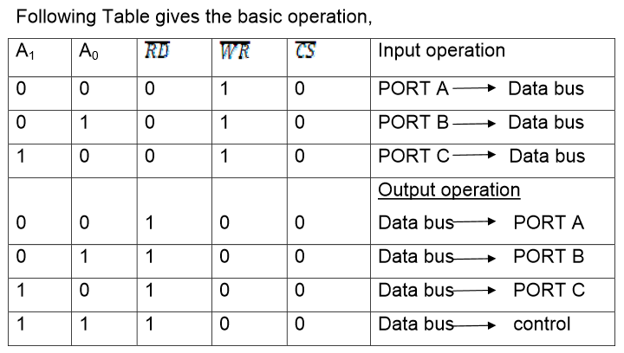

Slide 37
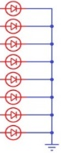
I/O Operation in Mode-0
Port A (8 bit)
8 LED
MPU
8255
Read
Port B (8 bit)
Write
8 LED
A0
A1
Port C_{Upper} (4 bit)
Reset
Control
Register
Port C_{Lower} (4 bit)
Switches
Chip Select

Slide 38



First write to the control register to configure
Port A (8 bit)
8 LED
MPU
10001001
8255
Port B (8 bit)
8 LED
A0 → 1
A1 → 1
Port C_{Upper} (4 bit)
Reset → 0
Control
Register
Port C_{Lower} (4 bit)
Switches
1 | 0 | 0 | 0 | 1 | 0 | 0 | 1

Slide 39
Then IO operation
Port A (8 bit)
8 LED
MPU
8255
Read
Port B (8 bit)
Write
8 LED
A0
A1
Port C_{Upper} (4 bit)
Reset
Control
Register
Port C_{Lower} (4 bit)
Switches
Chip Select

Slide 40
First write to the control register to configure
Port A (8 bit)
8 LED
MPU
10001001
8255
Port B (8 bit)
8 LED
A0 → 1
A1 → 1
Port C_{Upper} (4 bit)
Reset → 0
Control
Register
Port C_{Lower} (4 bit)
Switches
1 | 0 | 0 | 0 | 1 | 0 | 0 | 1

Slide 41
IO operation (in this cycle: MPU→Port A)
Port A (8 bit)
8 LED
MPU
11110000
8255
Port B (8 bit)
8 LED
A0 → 0
A1 → 0
Port C_{Upper} (4 bit)
Reset → 0
Control
Register
Port C_{Lower} (4 bit)
Switches
1 | 0 | 0 | 0 | 1 | 0 | 0 | 1

Slide 42
IO operation (in this cycle: MPU→Port B)
Port A (8 bit)
8 LED
MPU
data
8255
Port B (8 bit)
8 LED
A0 → 1
A1 → 0
Port C_{Upper} (4 bit)
Reset → 0
Control
Register
Port C_{Lower} (4 bit)
Switches
1 | 0 | 0 | 0 | 1 | 0 | 0 | 1

Slide 43




IO operation (in this cycle: Port C→MPU)
Port A (8 bit)
8 LED
MPU
data
8255
Port B (8 bit)
8 LED
A0 → 0
A0 → 0
A1 → 1
Port C_{Upper} (4 bit)
A1 → 1
Reset → 0
Control
Register
Reset → 0
Port C_{Lower} (4 bit)
Switches
1 | 0 | 0 | 0 | 1 | 0 | 0 | 1

Slide 44
Writing to Control word for Mode-1
MPU
8255
Port A (8 bit)
1010X11X
Control
Register
Printer
Read → 1
Write → 0
Port C_{Upper} (Pin 3, 6, 7)
A0 → 1
Port B (8 bit)
A1 → 1
Reset → 0
Keyboard
Chip Select → 0
Port C_{Lower} (Pin 0, 1, 2)
1 | 0 | 1 | 0 | X | 1 | 1 | X
Control Register

Slide 45


Write to the control register
MPU
1010X11X
8255
Port A (8 bit)
Printer
Port C_{Upper} (Pin 3, 6, 7)
A0→1
Port B (8 bit)
A1→1
Reset→0
Control
Register
Keyboard
Port C_{Lower} (Pin 0, 1, 2)
1 | 0 | 1 | 0 | X | 1 | 1 | X

Slide 46



Handshaking OUT operation with Port A
MPU
data
8255
Port A (8 bit)
PC7
PC6
PC3
INTR
A0 → 0
Port B (8 bit)
A1 → 0
Reset → 0
Control
Register
PC2
PC1
PC0

Slide 47
Handshaking IN operation with Port B
MPU
data
8255
Port A (8 bit)
PC7
PC6
PC3
A0 → 1
Port B (8 bit)
A1 → 0
Reset → 0
Control
Register
PC2
PC1
IBF
PC0
INTR

Slide 48
Programming 8255
Mode 1:
Ports A and B are programmed as input or output ports
Port C is used for handshaking
PA[7:0]
PA[7:0]
PC4
STB_{A}
PC7
OBF_{A}
PC5
IBF_{A}
PC6
ACK_{A}
PC3
INTR_{A}
PC3
INTR_{A}
8255
PB[7:0]
8255
PB[7:0]
PC2
STB_{B}
PC2
OBF_{B}
PC1
IBF_{B}
PC1
ACK_{B}
PC0
INTR_{B}
PC0
INTR_{B}
PC6, 7
PC4, 5
11-<number>

Slide 49
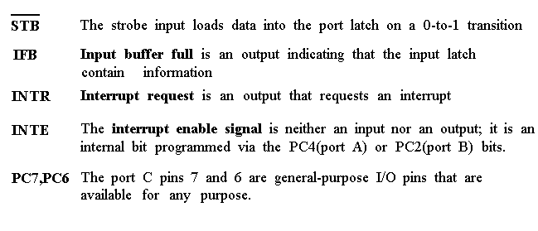
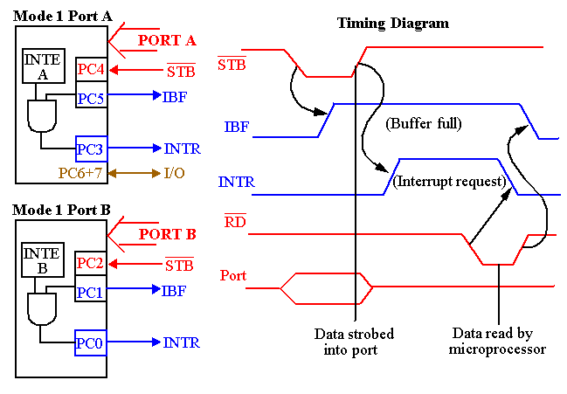

Slide 50







Handshaking out operation with Port A
MPU
8255
Port A (8 bit)
data
1
3
6
7
PC7
4
6
PC6
5
7
1
3
PC3
INTR
2
8
A0 → 0
Port B (8 bit)
A1 → 0
Reset → 0
Control
Register
PC2
PC1
PC0

Slide 51
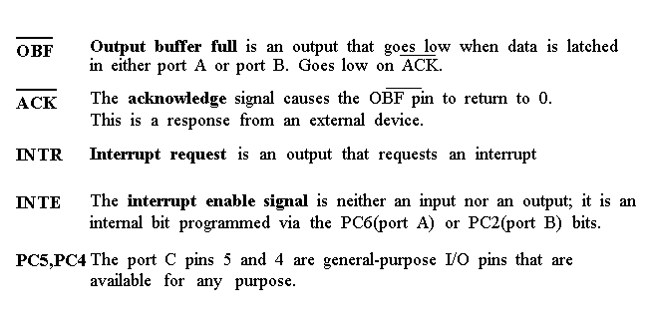
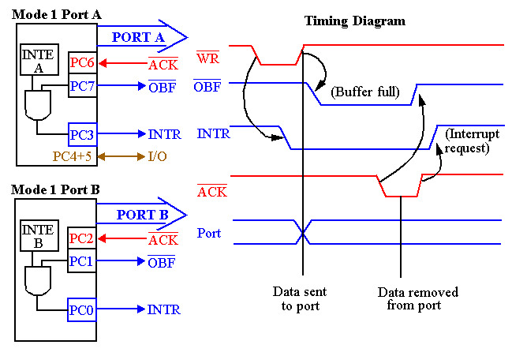

Slide 52






Handshaking in operation with Port B
MPU
8255
Port A (8 bit)
6
7
data
PC7
5
7
PC6
PC3
A0 → 1
Port B (8 bit)
A1 → 0
1
3
Reset → 0
Control
Register
PC2
1
3
PC1
2
8
IBF
PC0
4
6
INTR

Slide 53
Mode-2
Mode 2:
Port A is programmed to be bi-directional
Port C is for handshaking
Port B can be either input or output in mode 0 or mode 1
PA[7:0]
PC7
OBF_{A}
PC6
ACK_{A}
PC4
STB_{A}
8255
PC5
IBF_{A}
PC3
INTR_{A}
PC0
In Out
In Out
In Out
STB_{B} OBF_{B}
IBF_{B} ACK_{B}
INTR_{B} INTR_{B}
PC0
PC0
PB[7:0]
Mode 0
Mode 1
Can you design a decoder for an 8255 chip such that its base address is 40H?
Write the instructions that set 8255 into mode 0, port A as input, port B as output,
PC0-PC3 as input, PC4-PC7 as output ?
11-<number>

Slide 54



Handshaking I/O operation
Port A (8 bit)
MPU
8255
Port A (8 bit)
PC7
PC6
PC5
IBF
A0
PC4
A1
PC3
Reset
Control
Register
INTR

Slide 55
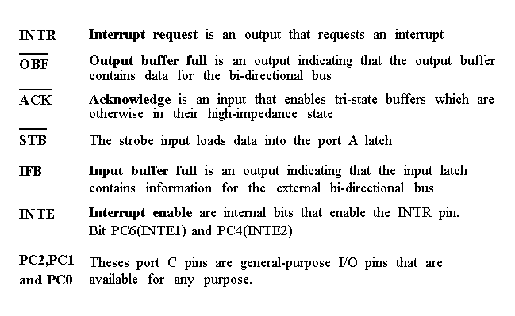
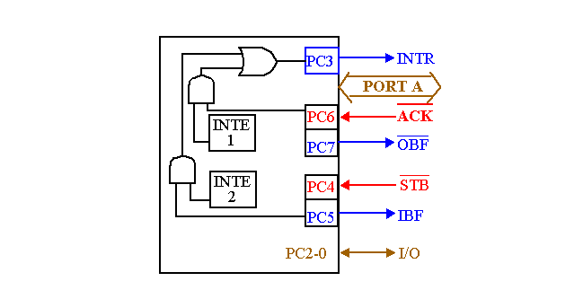
Timing diagram is a combination of the Mode 1 Strobed Input and Mode 1 Strobed Output Timing diagrams.

Slide 56
Handshaking I/O operation (OUT)
Port A (8 bit)
MPU
8255
Port A (8 bit)
PC7
PC6
PC5
IBF
A0→0
PC4
A1→0
PC3
Reset→0
Control
Register
INTR

Slide 57
Handshaking I/O operation (IN)
Port A (8 bit)
MPU
8255
Port A (8 bit)
PC7
PC6
PC5
IBF
A0→0
PC4
A1→0
PC3
Reset→0
Control
Register
INTR

Slide 58
Thank you
Q&A

